Slide 1

Home/Slice
Nada, Jeff, Collins & Dan
www.homeslicetoday.com

Slide 2
While at the same time, Statista published data highlighting the homeownership rate in the U.S. was 65% (in 2019).
CareerBuilder found that in 2019 78% of U.S. workers were living paycheck to paycheck.
Homeowners
According to a January 2020 CNBC article, Retail stock trading app Robinhood has grown from 1 million to 10 million users since 2016.
Investors

Slide 3
Background
Our goal is to provide seamless cash to homeowners while democratizing real estate investing. No monthly principal payments, no interest.
The Homeowner:
Even financially responsible individuals fall on hard times and need access to cash (fast), but obtaining much needed cash can be stressful, time consuming, and costly in the long-term.
CareerBuilder found that in 2019 78% of U.S. workers were living paycheck to paycheck.
While at the same time, Statista published data highlighting the homeownership rate in the U.S. was 65% (in 2019).
The Investor:
Investing in real estate is capital intensive and often reserved for more sophisticated investment professionals.
According to a January 2020 CNBC article, Retail stock trading app Robinhood has grown from 1 million to 10 million users since 2016.
To top things off, owning a home is expensive as lenders often require hefty down payments.
What if there was another option to get cash out of your home/diversify your investment portfolio?
…Welcome to HomeSlice…

Slide 4
Tools
Python (incl. Pandas, Flask, ZillowAPI, SQLAlchemy, scikit-learn and more)
JavaScript
SQL
AWS RDS
PgAdmin Database
HTML/CSS (incl. Bootstrap)
Tableau
Heroku

Slide 5
Data Flow
User
Address
Home Value
Cash Offer

Slide 6
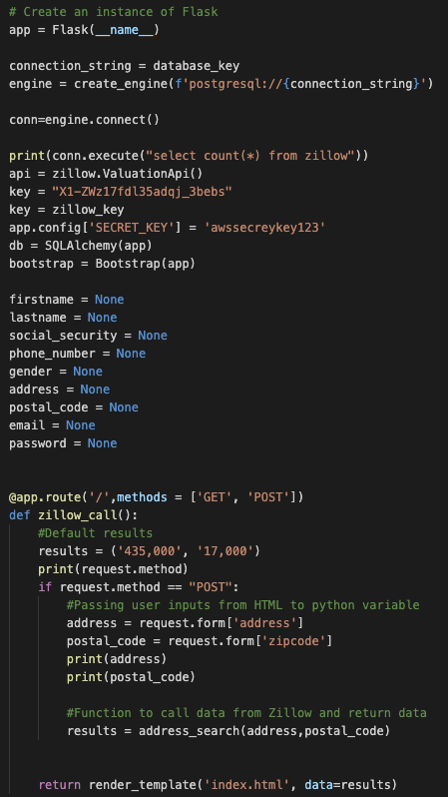
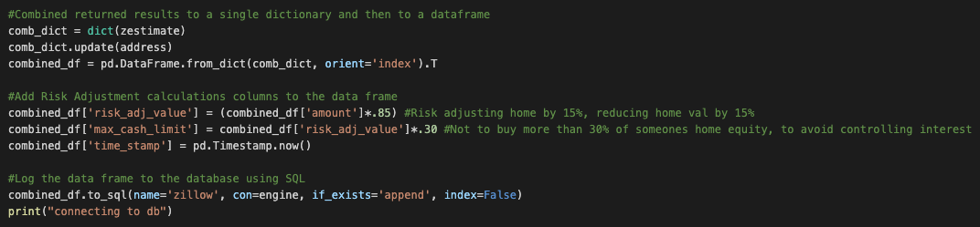
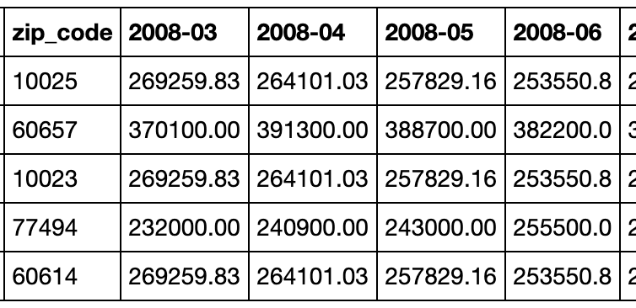
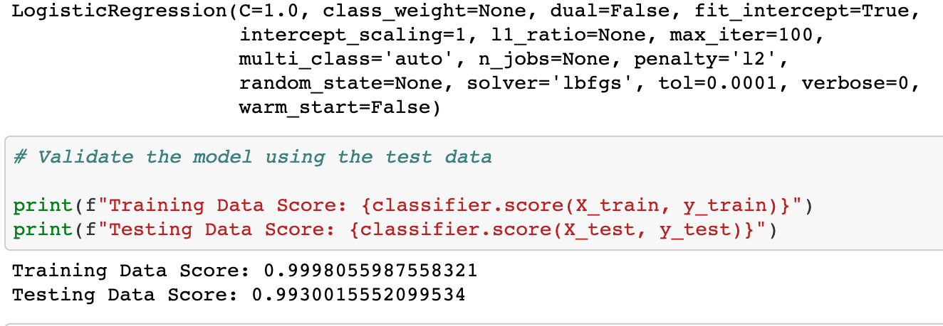
Back-End Code Overview
*We’re not going to show you our whole calculation ; )
1. Flask
2. DB & Calculation*
3. Historical Data Preview
4. Logistic Regression Model
JEFF

Slide 7
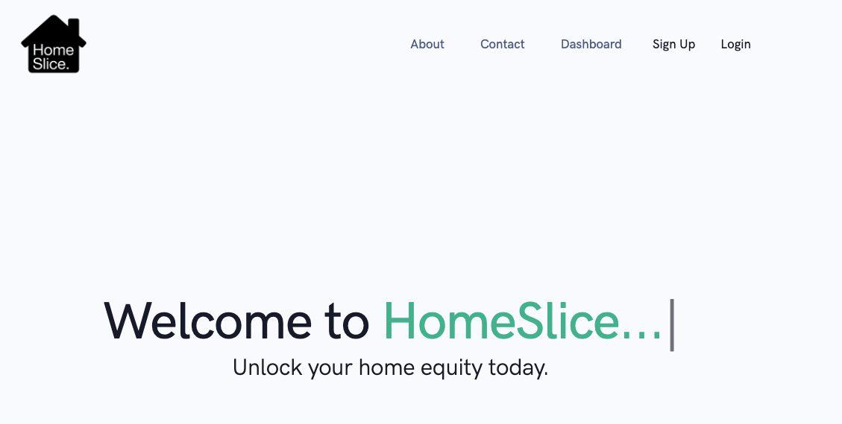
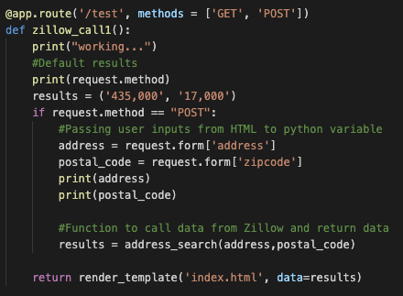
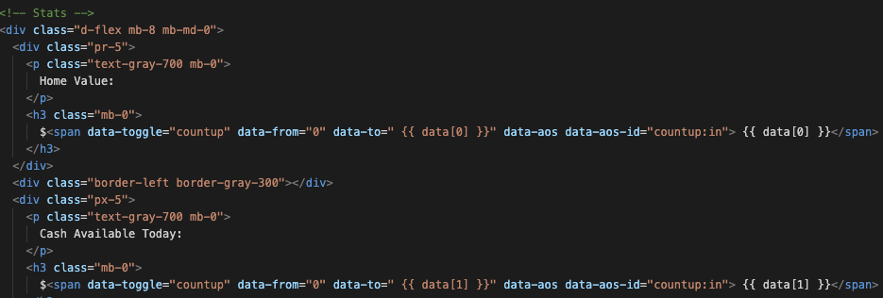
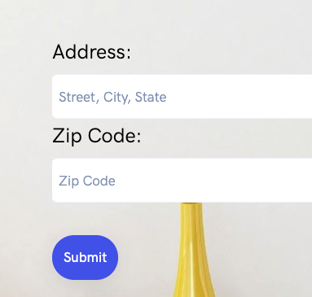
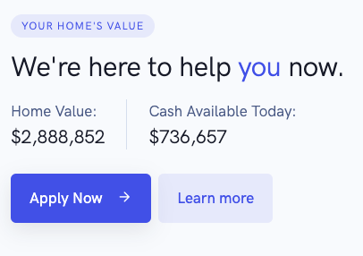
Front-End Code Overview
NADA

